Slide 1

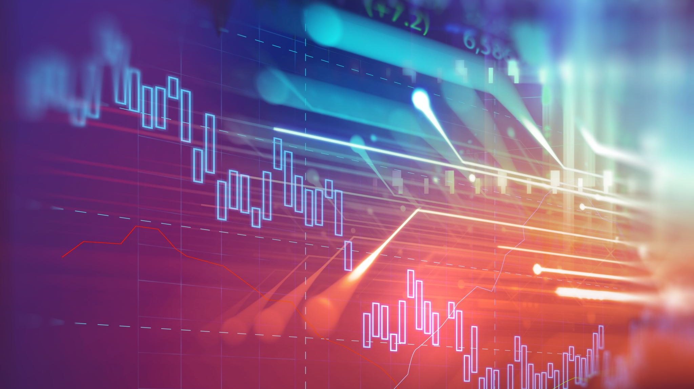
ITS 365 Web Mining Final Project
Richie Mohindroo
ITS 365 Dr. Munoz

Slide 2

What is Data Mining?
Data mining is the process of identifying patterns that exist within data.
With the patterns in hand, data analysts can apply them to other data sets
The data-mining process may involve the use of statistics, database querires, visualization tools, traditional programming, and machine learning

Slide 3
What is Machine Learning?
Machine learning is the use of data pattern-recognition algorithms which allow a program to solve problems, such as clustering, categorization, predictive analysis, and data association without the need for explicit step-by-step programming instructions to tell the algorithm how to perform tasks.
In this way, machine-learning solutions can solve complex problems by using data to drive discovery in using only a few lines of code.

Slide 4
Common tools used in Data-Mining
Common tools used in data-mining are…
MySQL or MongoDB
Excel
Tableau
Microsoft Power BI
Python, R, Java
RapidMiner, Orange, Weka

Slide 5
Data Science and Statistics
Data science is the use of statistics, programming, scientific methods, and machine learning to extract knowledge from a data set.
Statistics is the collection, analysis, modeling, and presentation of data. Statistics is one component of data mining, meaning it is one tool in the data-analysts tool kit.
One of the first steps data analysts perform to identify patterns within data is to represent the data visually, using charts and graphs.

Slide 6
Business Intelligence
Business intelligence is the use of tools, such as data-mining, machine-learning, and visualization, to convert data into actionable business insights and recommendations.
Business intelligence systems often include decision support tools that help users make better decisions.
Using historical data, such tools can describe what has happened and potentially, why.
Business intelligence software normally provides extensive visualization capabilities.

Slide 7
Data Quality
Before a data analysts can start the data-mining process, she or he should determine the quality of the data set and identify any anonalies, such as missing or outlier data that they will need to resolve.
Data quality is a measure of the data’s suitability for use.

Slide 8
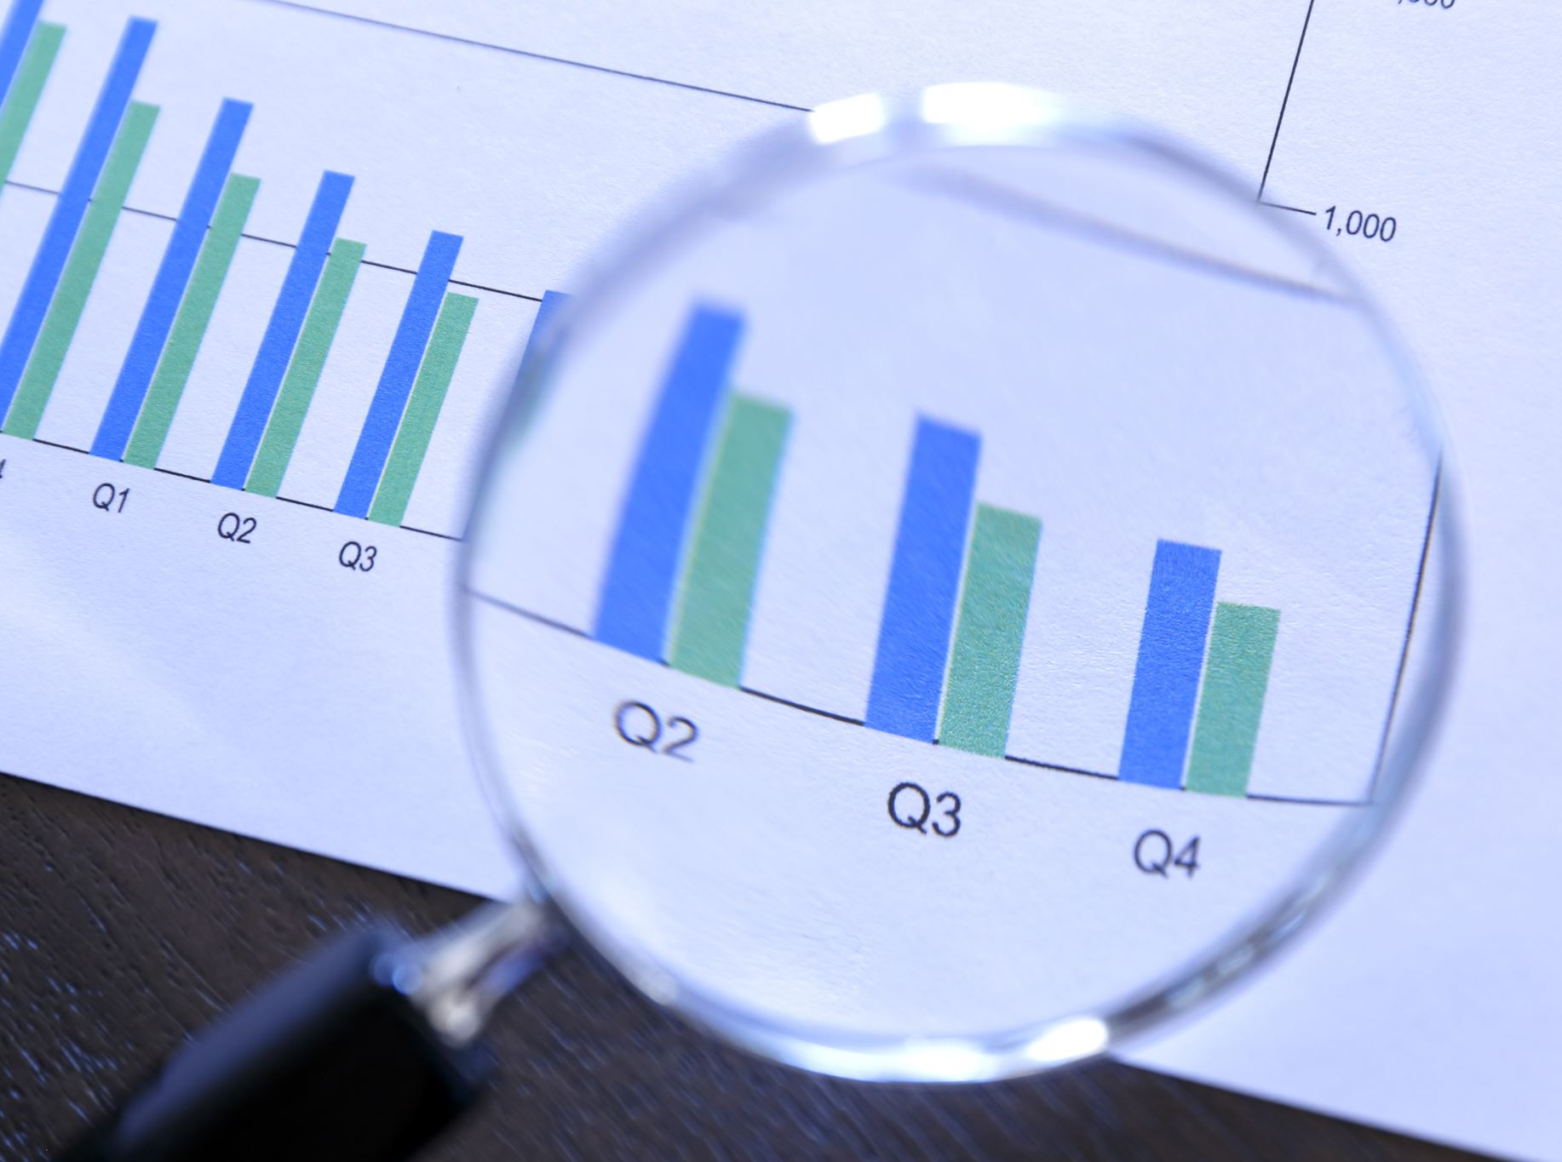
Data Quality Attributes
Accuracy: the degree to which the data correctly represents the underlying real-world values, such as all temperatures from a sensor being in the correct range.
Completeness: the degree to which the data represents all required values, such as a data set that should contain an hour of data, for a sensor that reports every second; having 100% of the data values.
Consistency: the degree to which similar or related data values align throughout the data set, such as each occurrence of an address having the same zip code.
Conformity: the degree to which the data values align with the company’s business rules, such as: ”The company will measure and store sensor values on 1-second intervals.”

Slide 9
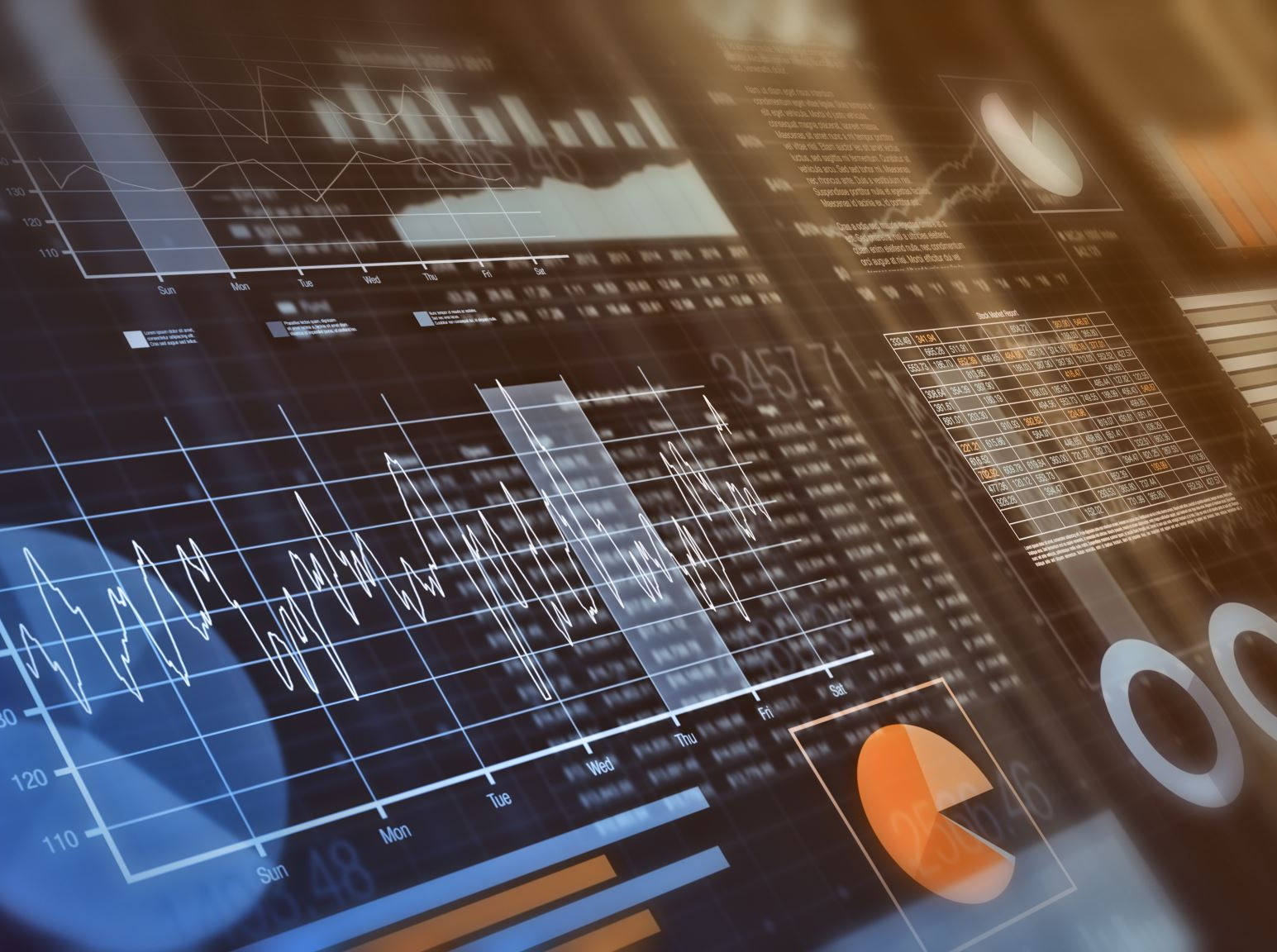
Data Clustering
There are quite a few methods you can use to analyze your data, such as data association, data classification, linear regression, etc., but I felt as if data clustering would be the best for my data.
Data clustering is the process of grouping related data-set items into one of more clusters.
Clustering uses an unsupervised machine-learning algorithm, which means the algorithm does not use a training data set.

Slide 10
My Data
The hunt for finding fascinating data was quite simple for me. Since I am a sports fan, I decided to look into player statistics as good quality data to analyze.
I came upon the stats of the top players in the NFL in 2020.
This data consisted of how many touchdowns these players had, how many points they had in fantasy, how many fouls, passes thrown, total yards, etc.

Slide 11
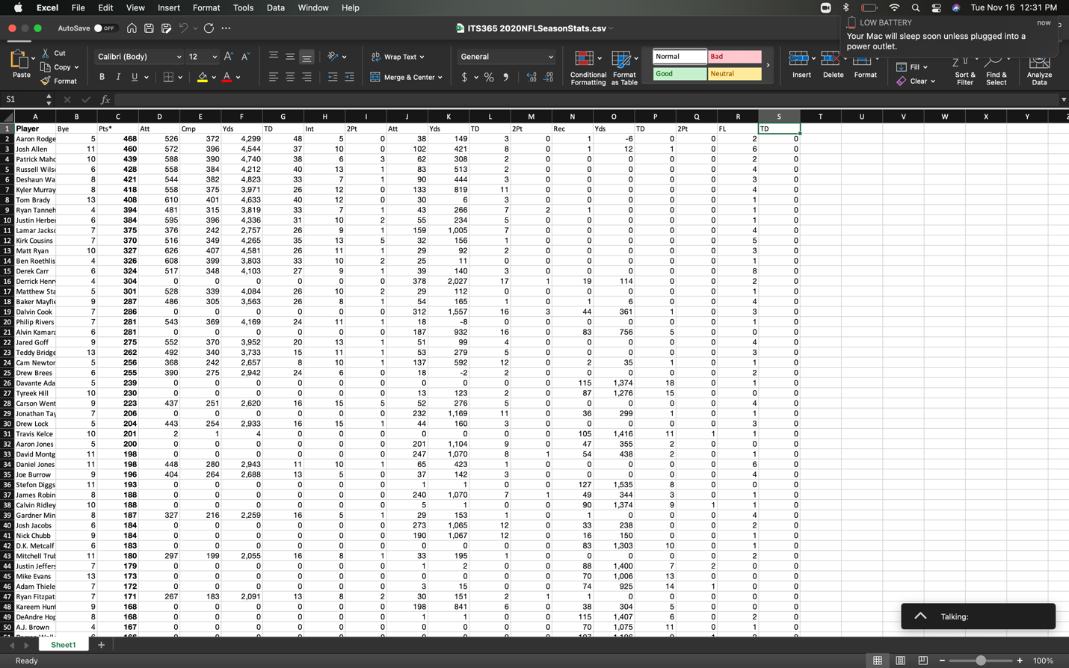
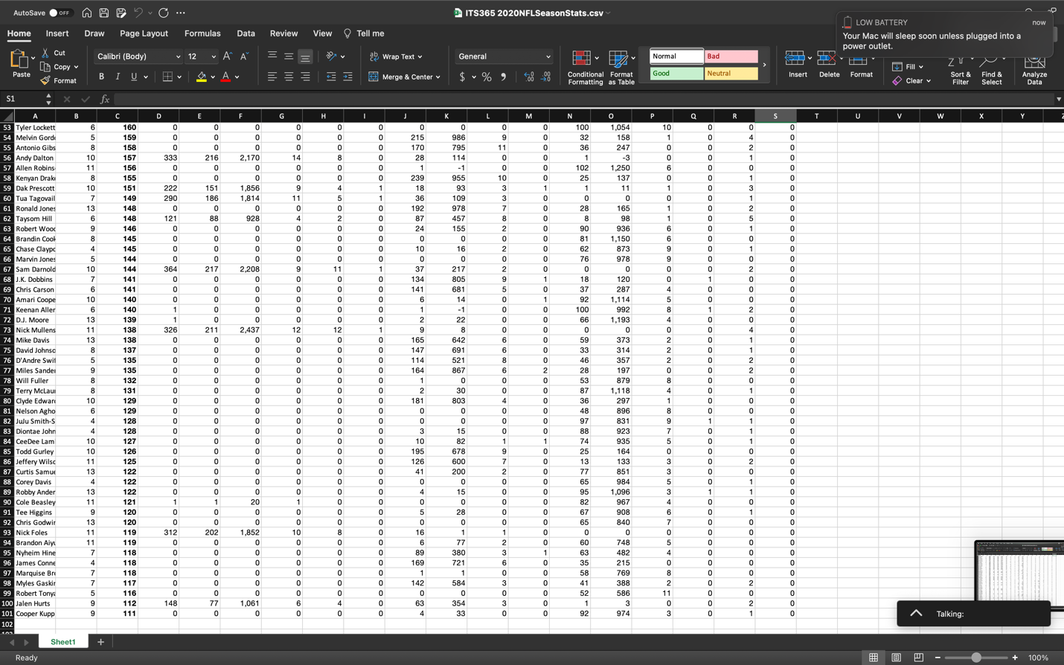
My Data

Slide 12
My Data Issues
I did not have too many issues trying to work with my data.
Trying to gather the data and implementing it to Weka was the only challenging part, but it was all figured out after viewing Dr. Munoz’s lectures.
Using the tools in Weka were also quite simple and also quite fascinating in my opinion, I was not aware that we can do all this with some simple data.
My data was also very cooperative with Weka and did not fail me while working on the labs in class.
I also learned how to get the functions to work on Weka which was simply trying to figure out if the function prefers nominal or numerical. I also learned that getting rid of strings in the data made the function work as well.

Slide 13
How I Analyzed My Data
After further discussion with Dr. Munoz, I was advised to break my data down to 3 quarterbacks and figure out who performed the best out of the 3.
I was advised to use data clustering to do this analyzation.
Since Dr. Munoz is a Ravens fan, I decided to use quarterback Lamar Jackson, Tampa Bay QB Tom Brady, and Chiefs QB Patrick Mahomes.
These 3 QB’s are hands down the best QB’s in the league right now as well as in 2020, so it was quite interesting to try to figure out who was the best player.

Slide 14
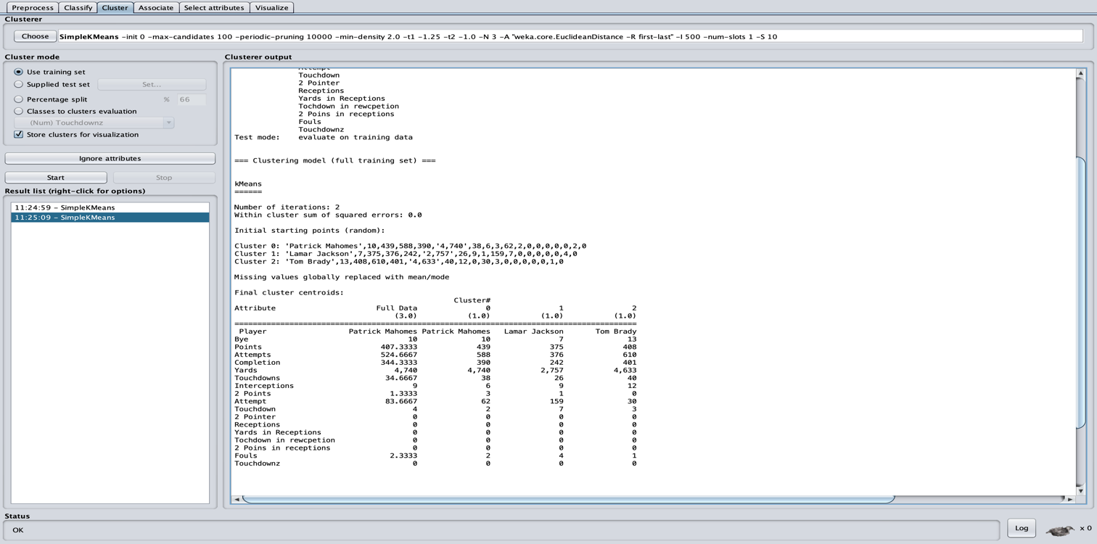
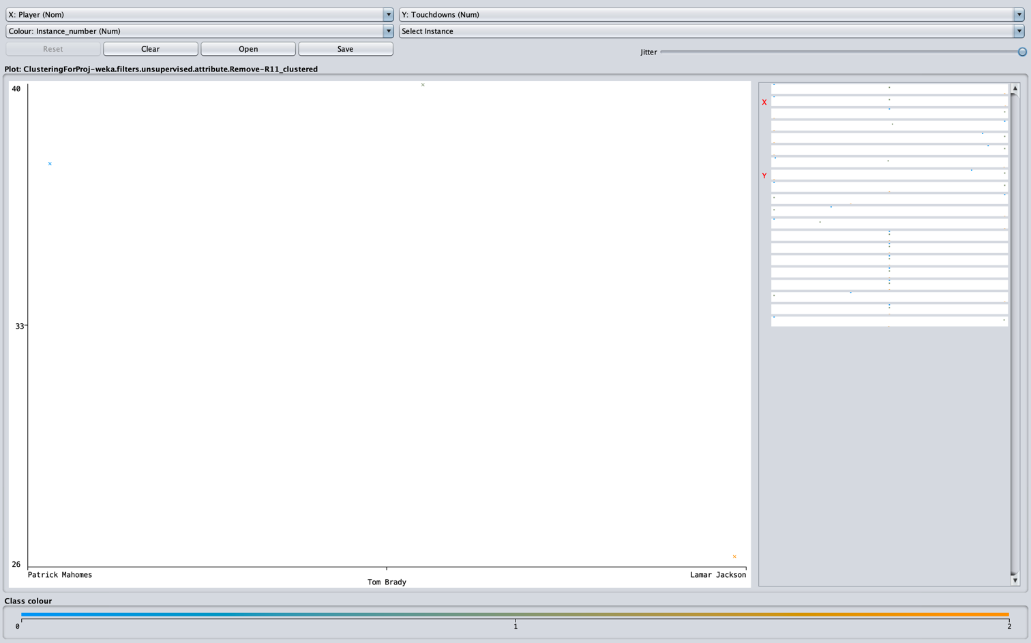
How I Analyzed My Data

Slide 15
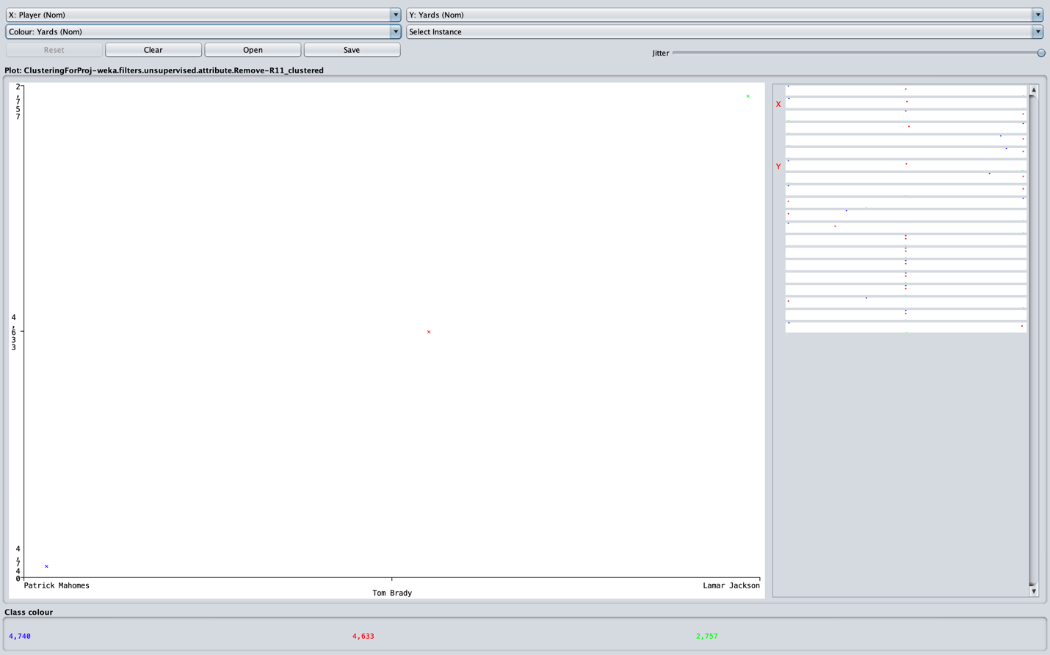
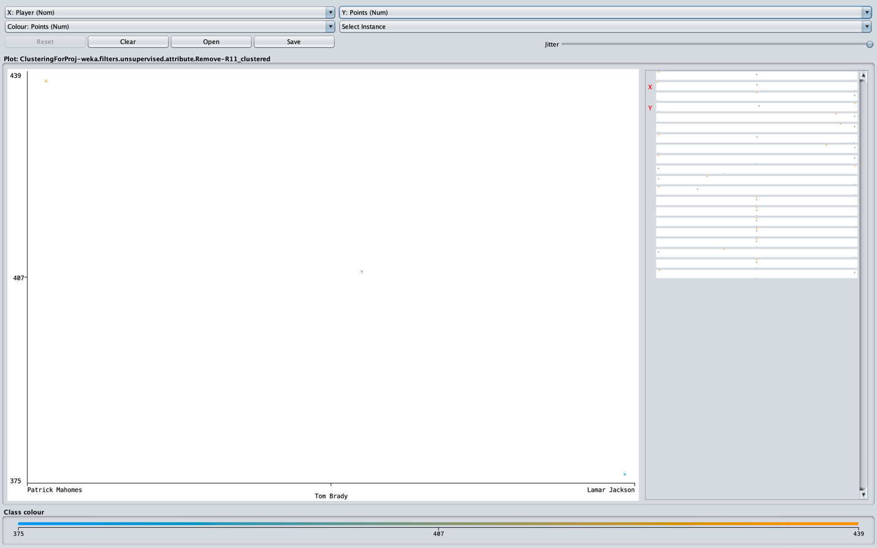
How I Analyzed My Data

Slide 16

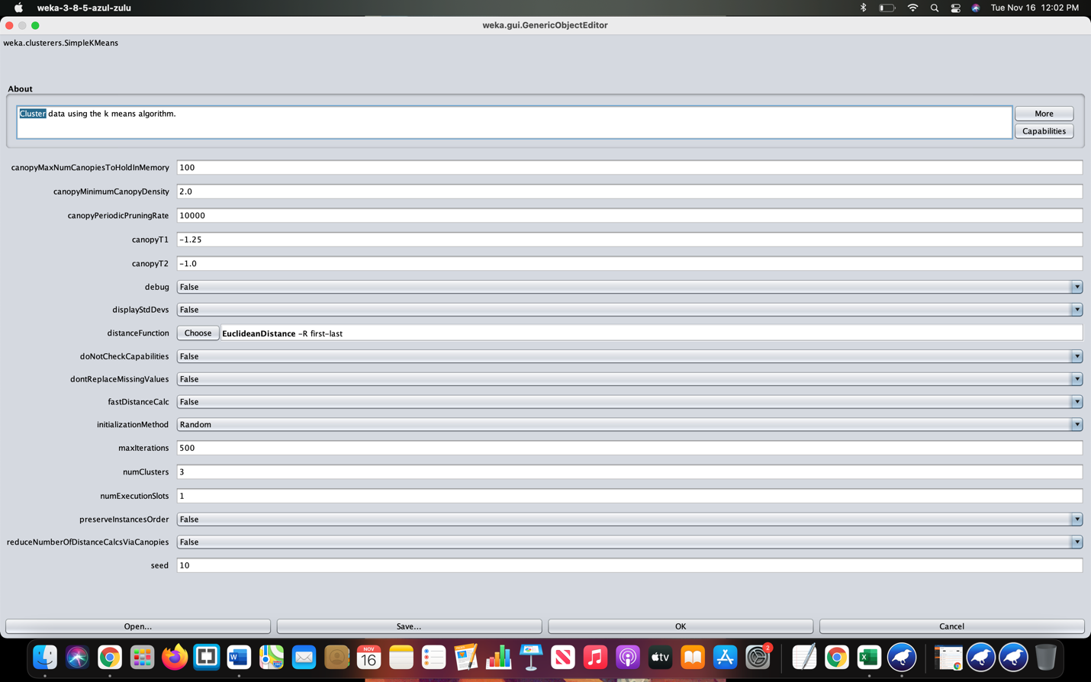
How I Analyzed My Data

Slide 17
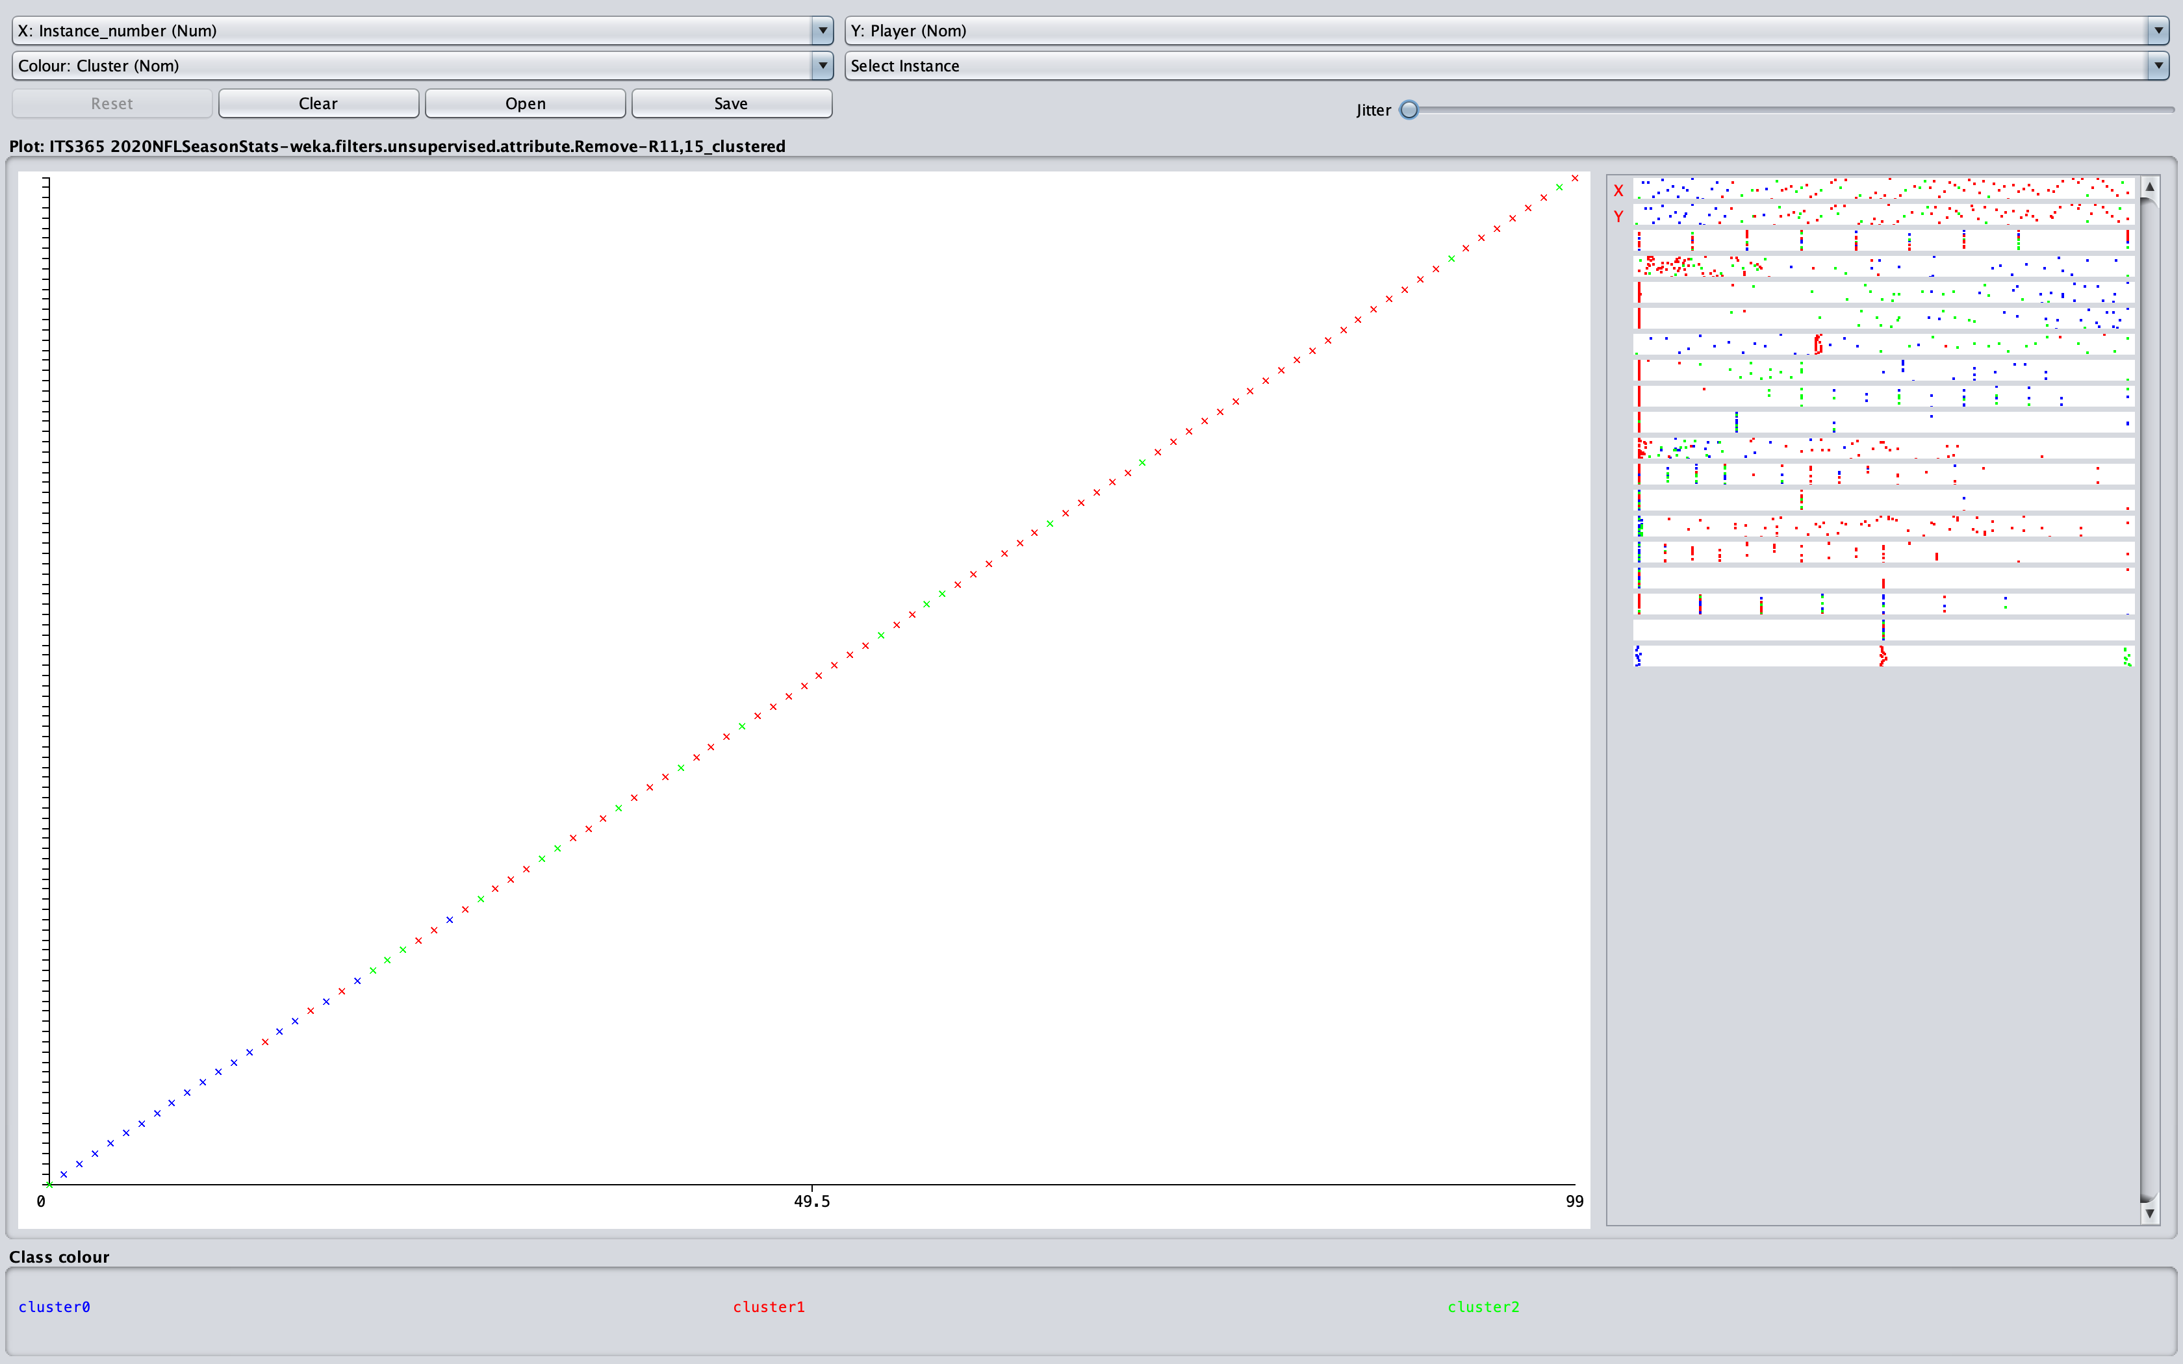

How I Analyzed My Data

Slide 18


Data Conclusion
Going back over the screenshots of my data from the clustering process, I included arrows to help better see where each of the points were on the chart. I decided to separate each stat into their own to get a better viewing and understanding of where each quarterback is performing well. I also went ahead and decided to show how I set up my visuals and how I set the three quarterbacks into their clusters.
After going over each of those stats, I have concluded that the quarterback that performed the best in 2020 would be Patrick Mahomes. Patrick Mahomes threw for the most yards out of the three quarterbacks and was only two touchdowns shy from beating Tom Brady. I chose Patrick Mahomes over Tom Brady due to the simple fact that Tom Brady had a lot of interceptions that year. Patrick Mahomes also had the most fantasy points out of the three quarterbacks, and he also led his team to the super bowl that year against the San Francisco 49ers. Although Dr. Munoz is a huge fan of Lamar Jackson, he did not have the greatest of seasons as he only threw for 2,757 yards and had only 26 touchdowns compared to the other two quarterbacks.

Slide 19

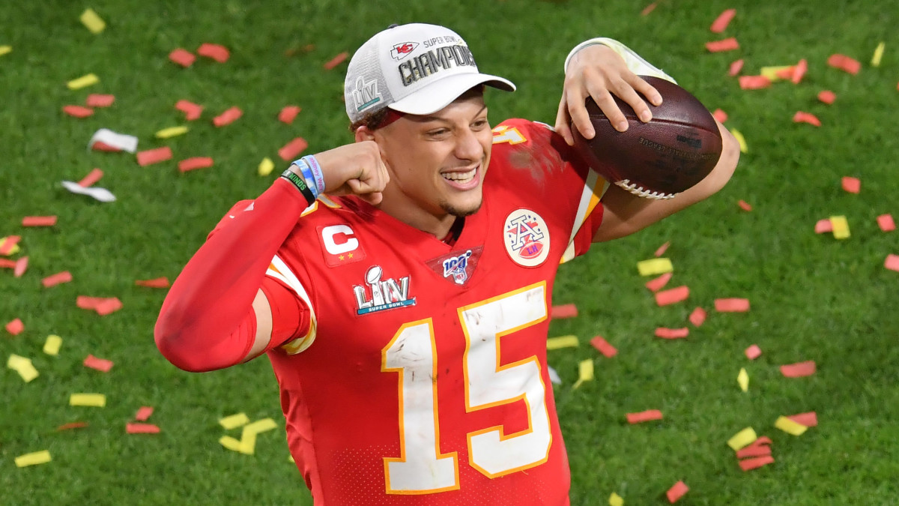
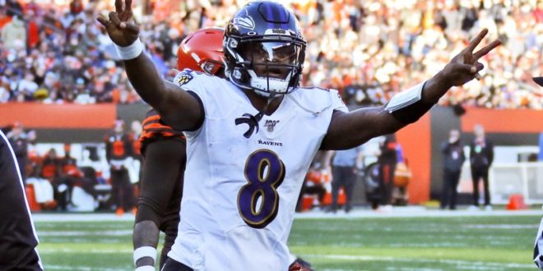
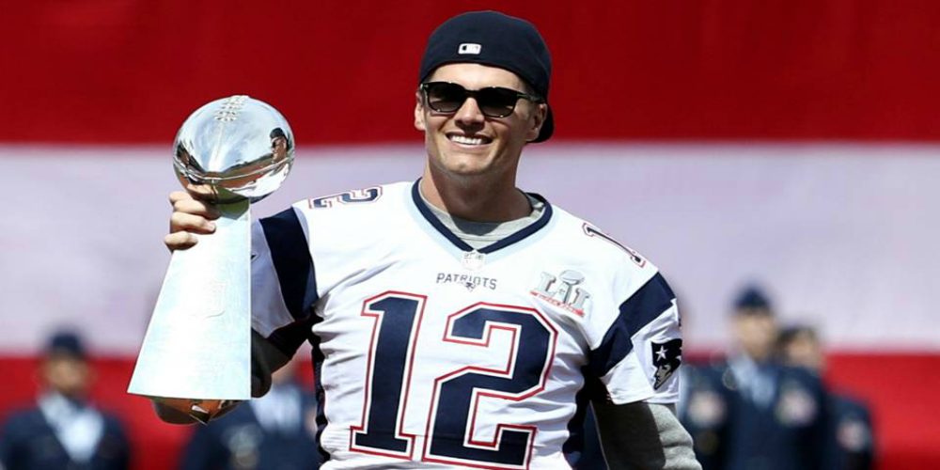
Thank You Class and Dr. Munoz
This Photo by Unknown Author is licensed under CC BY-SA-NC
This Photo by Unknown Author is licensed under CC BY-NC-ND
This Photo by Unknown Author is licensed under CC BY-NC-ND

